Slide 1
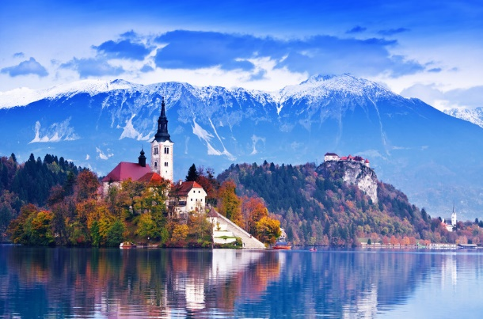
SLOVENIA
DOING BUSINESS ON THE SUNNY SIDE OF ALPS

Slide 2
The country
The economy
Doing businness in Slovenia
Servis Koper – Who we are
Our services
Why we join CH International

Slide 3
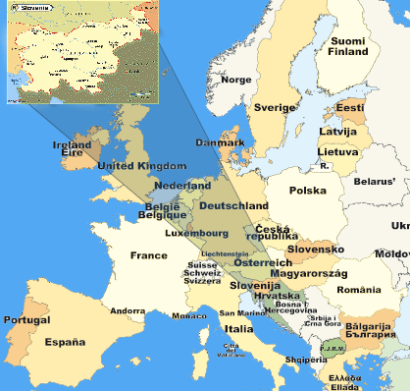
Slovenia a small country on the top of the Adriatic Sea

Slide 4
Slovenia – the country
Population | 2,064,188
Area | 20,273 km
Capital | Ljubljana (280,300 inhabitants)
Major towns | Maribor (110,950); Celje (48,700); Kranj (55,450), Koper (53,150); Novo mesto (36,400)
EU member state | Since the 1st of May 2004
OECD member country | Since May 2010
Adoption of EURO and entry into Schengen | The 1st of January 2007

Slide 5
Slovenia – the economy
MAIN MACROECONOMIC INDICATORS | 2014 | 2015 | 2016 forecast | 2017 forecast | 2018 forecast
GDP real growth rate (%) | 3.0 | 2.9 | 1.7 | 2.4 | 2.3
GDP per capita, in EUR | 18,093 | 18,680 | 19,179 | 19,670 | 20,283
External debt as % of GDP | 124.2 | 116.0 | - | - | -
Rate of unemployment by ILO in % | 9.7 | 9.0 | 8.6 | 8.1 | 7.5
Inflation rate | 0.2 | -0.5 | -0.3 | 1.3 | 1.3

Slide 6
Slovenia – the economy
MARKET | € MILLION
Germany | 4,948
Italy | 2,691
Austria | 2,024
Croatia | 1,864
Ex YU countries (Srb, BiH, Mk) | 1,679
France | 1,182
Poland | 816
Hungary | 695
Czech Republic | 557
Russian Federation | 792
USA | 692
Switzerland | 401
Turkey | 259
Other countries | 3,867
TOTAL | 23,940
Export by country
(in 2015)

Slide 7
Slovenia – the economy
Export categories of goods
(in 2015)

Slide 8
Slovenia – the economy
Foreign direct investments sort by country of origin
(in 2015)

Slide 9
Doing business in Slovenia
- Corporate income tax: 17%
- Tax relief: -up to 100% of the amount invested in R&D
-up to 40% of the amount invested in equipment and intangible long-term assets
-tax relief on employment of certain group of workers
- Personal income tax: progressive rates 16%, 27%, 41% and 50%
- Income tax on interests, dividends and capital gains:
20% interests, 20% dividends, 0 – 25% capital gain (depends on a holding period)
- Property tax: 0% Immovable property transfer tax: 2%
- VAT: 22% standard rate, 9,5% reduced rate (including food)
- Social security contributions:
employer – 16,1%
employee – 22,1%

Slide 10
Doing business in Slovenia
Why doing business in Slovenia?
Four qualities of the country
Quality workforce
Quality link to regional markets – the so called door to the Balkans
Quality infrastructure
Quality of life

Slide 11
Who we are
Accounting firm based in Koper – the most important Port in the Adriatic sea
Established in 2004
Services are performed by:
- 4 partners (trusted and chartered tax consultants, work advisors and lawyers)
3 accountants
All staff speak excellent slovenian, italian and serbian/croatian language
We also work very close with other specialized lawyers, work advisors and auditors
Flexibility and adaptability
We operate either with small, medium and large companies

Slide 12
Who we are
Type of clients:
Manufacturing
Services
Insurance
Trade
Transport

Slide 13
Our services
Accounting
Income tax
Tax compliance and planning
Work advice and payroll
Due diligence
International consultancy
Business advisory
Financial statements
Setting up companies
Assisting in opening VAT numbers and bank accounts

Slide 14
Reasons for joining C.H.International
Helping our clients finding quality partners abroad
Enhance the reputation of our firm with a quality partnership
Acquire new clients

Slide 15
Thank you and enjoy the Conference

Slide 16
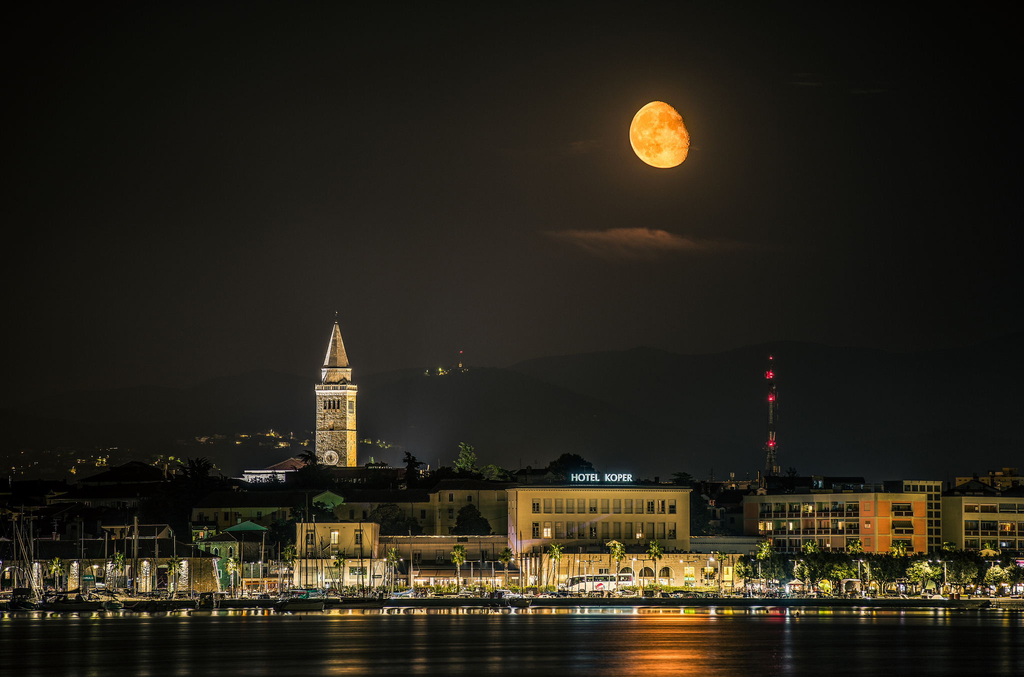
SERVIS KOPER D.O.O.
Ferrarska ulica 14
6000 KOPER
SLOVENIA
info@servis-koper.si
www.servis-koper.si
(coming soon)

